Slide 1

Modeling in Operations Management Project
Inventory Optimization (Newsvendor Model)
Presented by : Group 10
Parth Tyagi 20BM6JP03
Anuj Maingi 20BM6JP16
Rahul Sharma 20BM6JP17
Prasun Kumar 20BM6JP26
Satyam Anand 20BM6JP35
Sisir Kumar Das 20BM6JP59
Satyam Neelmani 20BM6JP62
10

Slide 2
NEWSVENDOR PROBLEM
There are two types of optimization problems:
Non repeated decisions
Example – Hiring Secretary problem
Repeated Decisions
Example – Newsvendor problem
Newsvendor problem is applicable for:
Perishable products mainly
Only one product
Problem: Determine the appropriate quantity to buy and stock
Stocking too many causes throwing away remaining items, holding cost (c_{h})
Stocking too few means lost opportunity, shortage cost (c_{p})
Demand distribution is needed to solve it analytically

Slide 3


MODELING
The optimal order quantity can be obtained by solving:
If distribution of demand is known, the optimal solution is given by
d – random demand
y – order quantity
c_{p} – per quantity shortage cost
c_{h} – per unit holding cost
a⁺ - max{0,a}

Slide 4
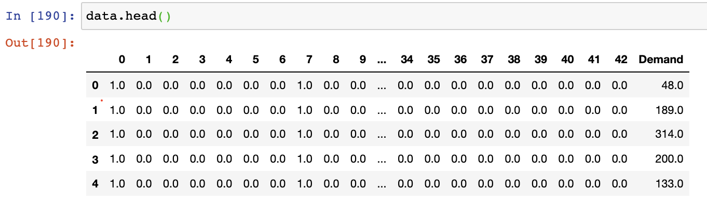
DATA DESCRIPTION
Original Data
3 Features – Department, Day of Week and Month of Year
Department – 23 Product Categories
Days of Week – 7 levels
Month – 12 levels
13170 Demand Records
2 Years data

Slide 5
DATA DESCRIPTION
Further Steps
More relevant features e.g Temperature etc can be collected which can help improve the prediction quality.
More data can be collected.
Lot of Categorical Variable in the data. So Processing required as they cannot directly be fed to machine learning algorithms
One Hot Encode can be used to overcome this.
Train Data (75%)
Final Data
43 Columns
13170 rows
Validation Data (12.5%)
After One-Hot Encoding
Test Data (12.5%)

Slide 6


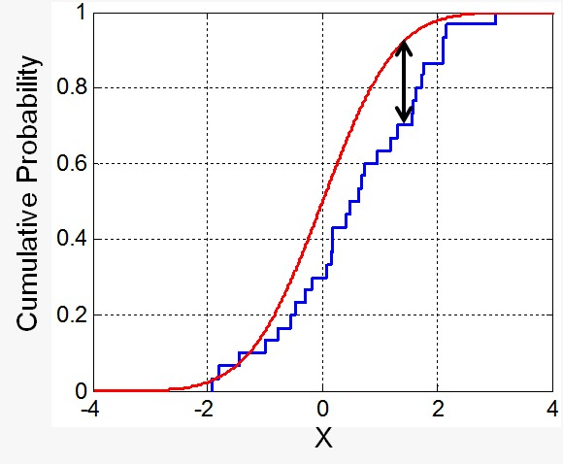

DISTRIBUTION HYPOTHESIS TESTING
Kolmogorov Smirnov (KS) Test
Performs two-sample test to check if the dataset provided belong to the same distribution
Null Hypothesis, H0: x and y drawn from the same distribution
Alternate Hypothesis, Ha: x and y drawn from different distribution
Normal Distribution
P value < 2.2e-16
Very small p-value => Reject Null Hypothesis
The demand data does not follow normal distribution
Exponential Distribution
P value < 2.2e-16
Very small p-value => Reject Null Hypothesis
The demand data does not follow exponential
Log Normal Distribution
P value < 2.2e-16
Very small p-value => Reject Null Hypothesis
The demand data does not follow log normal

Slide 7
APPROACHES
Distribution Known?
Yes
No
SEO
Simple Approaches
EQ
EQ with Clustering
KNN
DNN
Separated Estimation & Optimization
Analytical Solutions
Empirical Quantile
Use of features
K-Nearest Neighbor – Machine Learning
Deep Learning

Slide 8
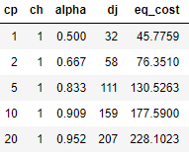

EQ METHOD
EDF (Non Parametric Method to Estimate CDF)
Sort the dataset in ascending order
d₁ <= d₂ <=…<= d_{n}
Estimate the α_{th} quantile of the demand distribution, F⁻¹(α)
Select demand d_{j} such that
Results:
ADVANTAGES
EQ does not assume a particular form of the demand distribution and does not approximate the probability distribution, so it avoids those pitfalls
DISADVANTAGES
it does not use the information from features.

Slide 9
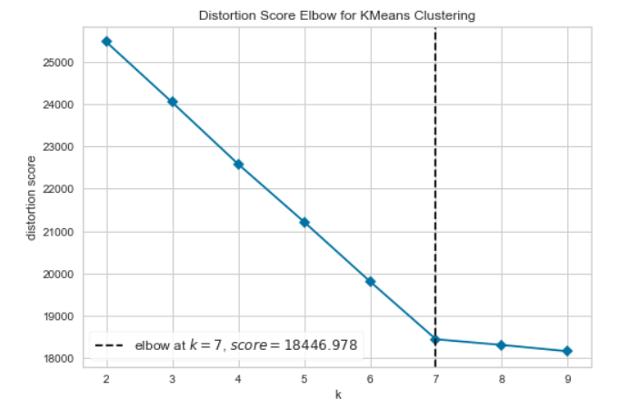
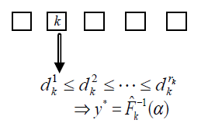
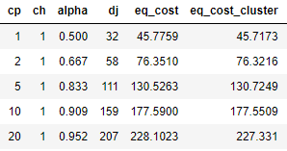
CLUSTERING FOLLOWED BY EQ METHOD
STEPS
Performed Clustering using K-Means and estimated K using Elbow Method
7 Clusters were formed
Perform EQ over each cluster
RESULTS:
DISADVANTAGES
Inter-Cluster information will not be used to find base stock level.

Slide 10
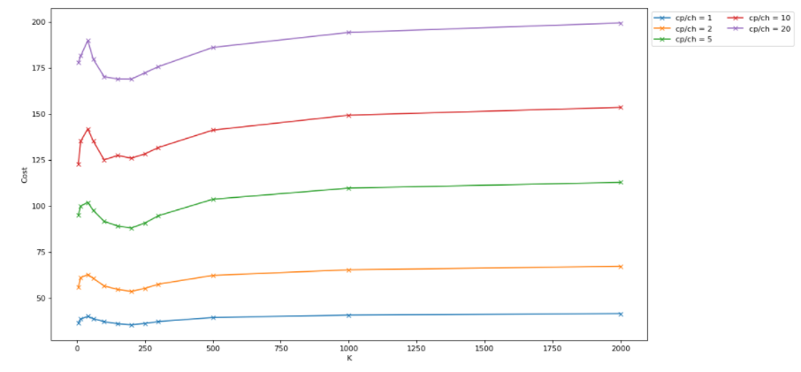

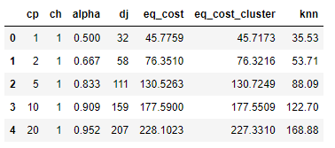
K-NEAREST NEIGHBOR (KNN) METHOD
c_{p}/c_{h}
STEPS:
KNN identifies the set of nearest historical records to the new observation x such that
Then assign weights w_{i} = 1/k for all i ϵ N(x) (and zero otherwise).
Base stock level q,
Where d_{j} are the ascending sorted demands.
k = 200, that means 200 nearest neighbors were considered
RESULTS:

Slide 11
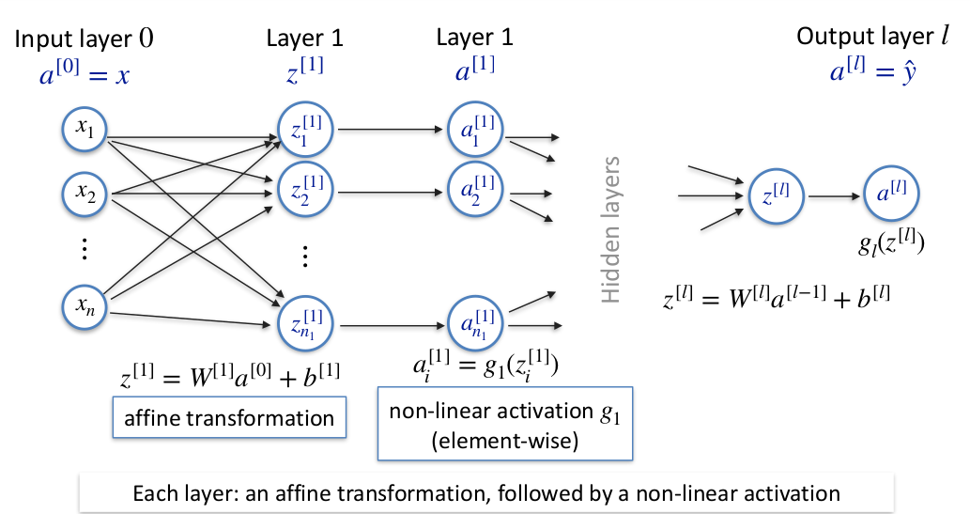
Deep Learning (Feed Forward Neural Network)

Slide 12
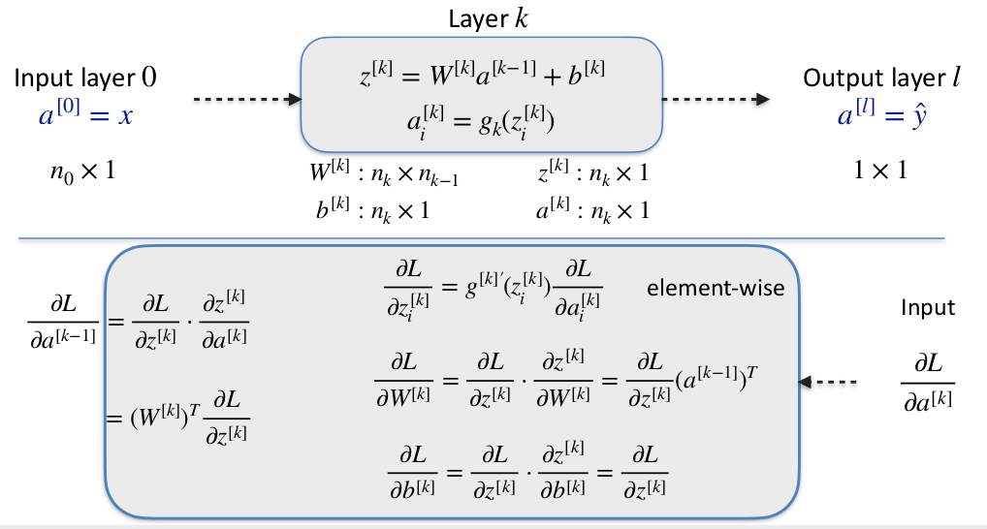
Deep Learning (Optimization Algorithm - Backpropogation)

Slide 13
Why Deep Learning
Traditional OR Methods first estimate the demand distributions and then use it to estimate the optimal order quantity.
However in Deep Learning we directly estimate the optimal order quantity.
Deep learning algorithm is used to obtain the minimum cost directly, rather than first estimating the demand distribution and then choosing an order quantity.

Slide 14
Hyperband Algorithm Description
Objective :
To find the best neural network architecture
Optimizing run time complexity
Methodology:
i) Creating 100 random models
ii) Iteratively move towards optimization in step size of 5 epochs
iii) Remove 10% of the worst performing models
iv) Iterate till we obtain the best neural network architecture.

Slide 15
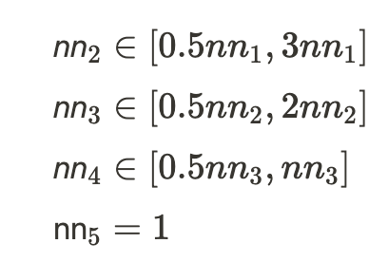
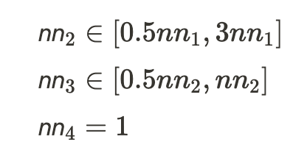
Stochastic Architecture Creation
Layers Stack
2 or 3 hidden layers in our models.
Nodes Configuration
The number of nodes for these layers are then defined randomly.
For Network with 2 Hidden Layers
For Network with 3 Hidden Layers

Slide 16
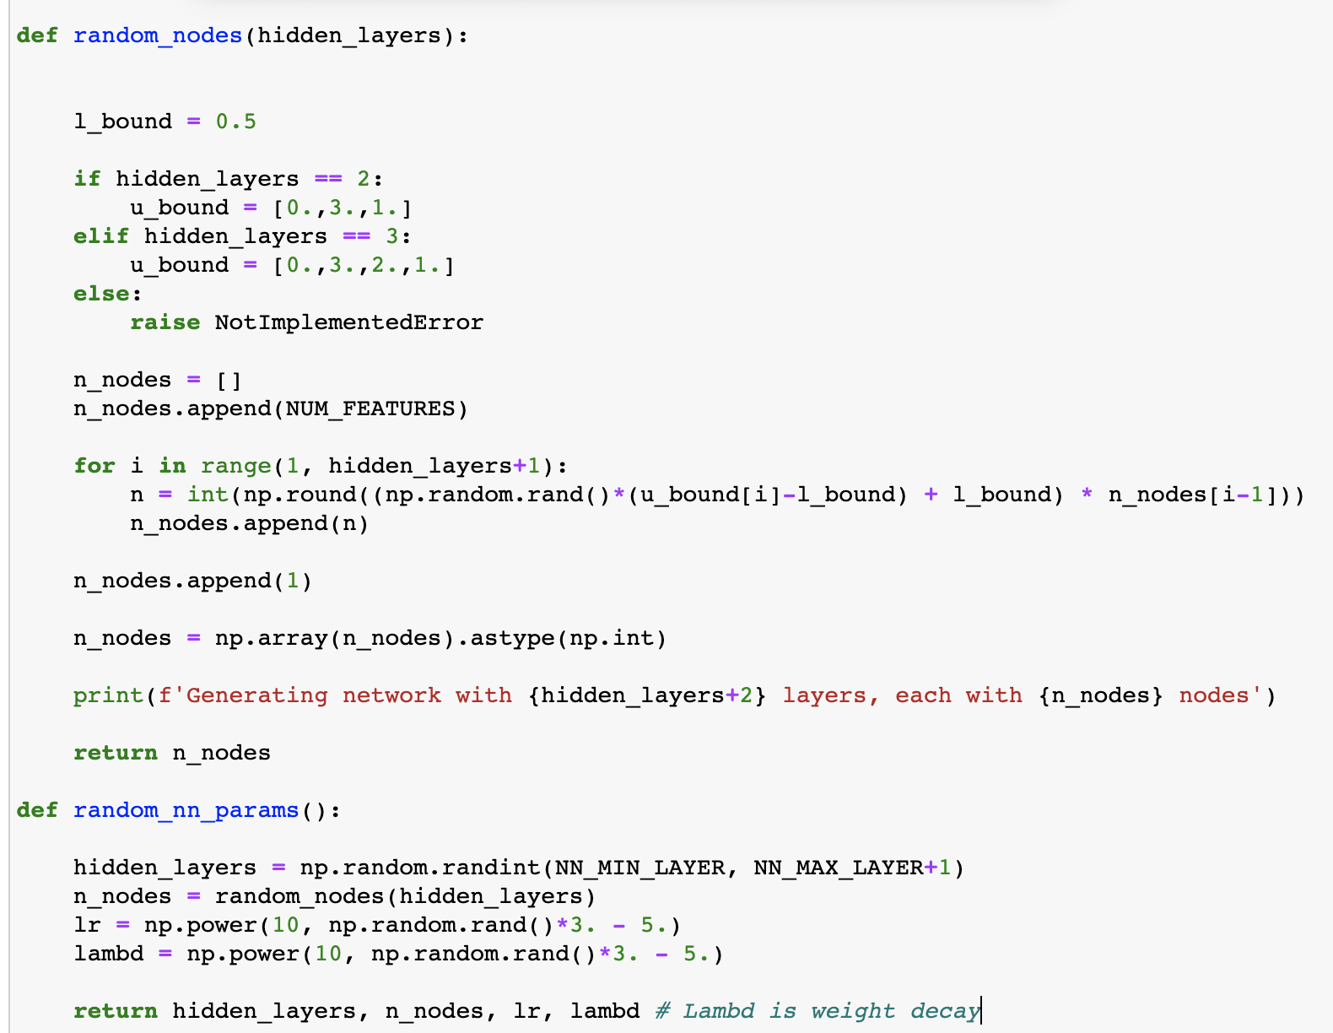

Slide 17

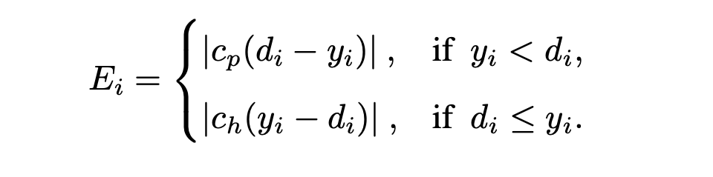
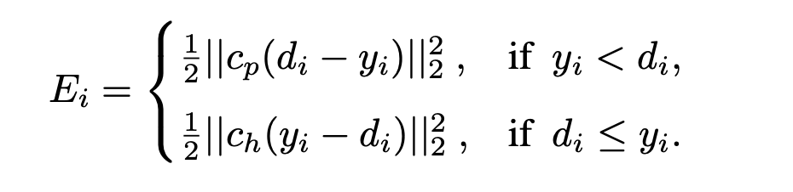
Loss Functions
Original Cost Function
DNN-L1 Loss Function
DNN-L2 Euclidean Function

Slide 18
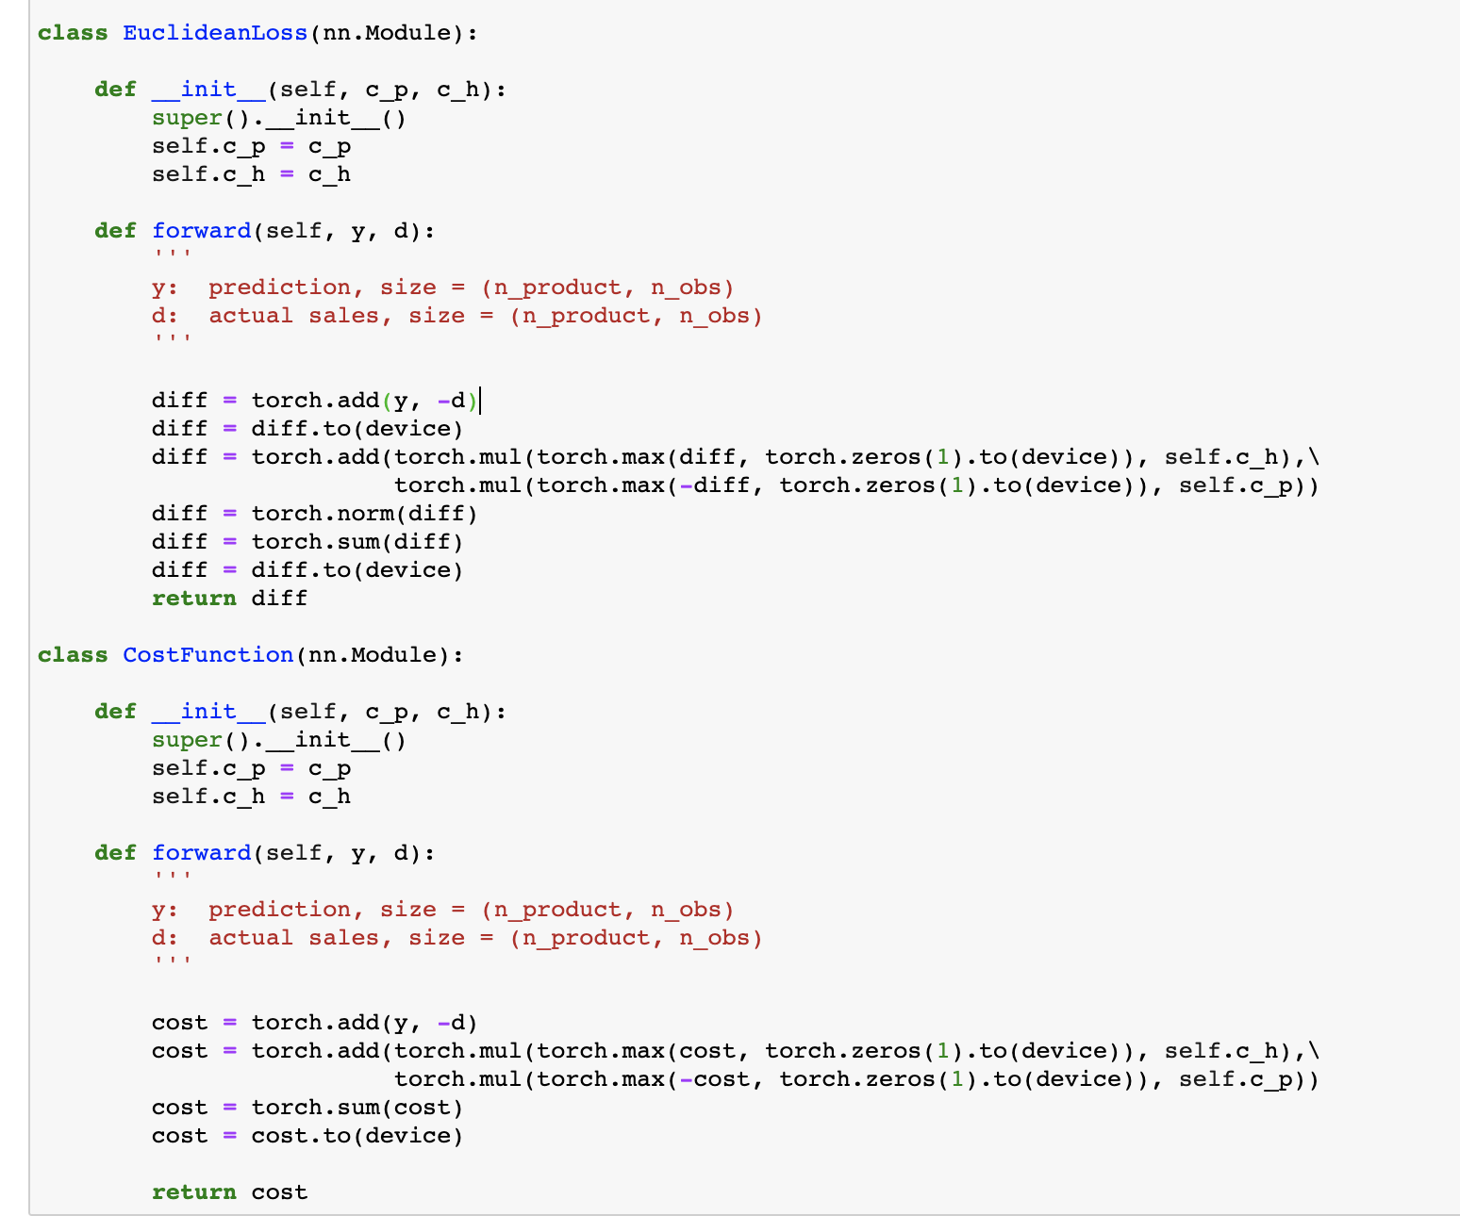

Slide 19
Generating Architecture
Deep Neural Network - L1
Building Blocks
Leverage Building Blocks
Use L1 Cost Function
Layer Creation
Initializing Weights
Regularization
Leveraging efficient optimizer
Deep Neural Network - L2
Leverage Building Blocks
Use Euclidean Cost Function

Slide 20
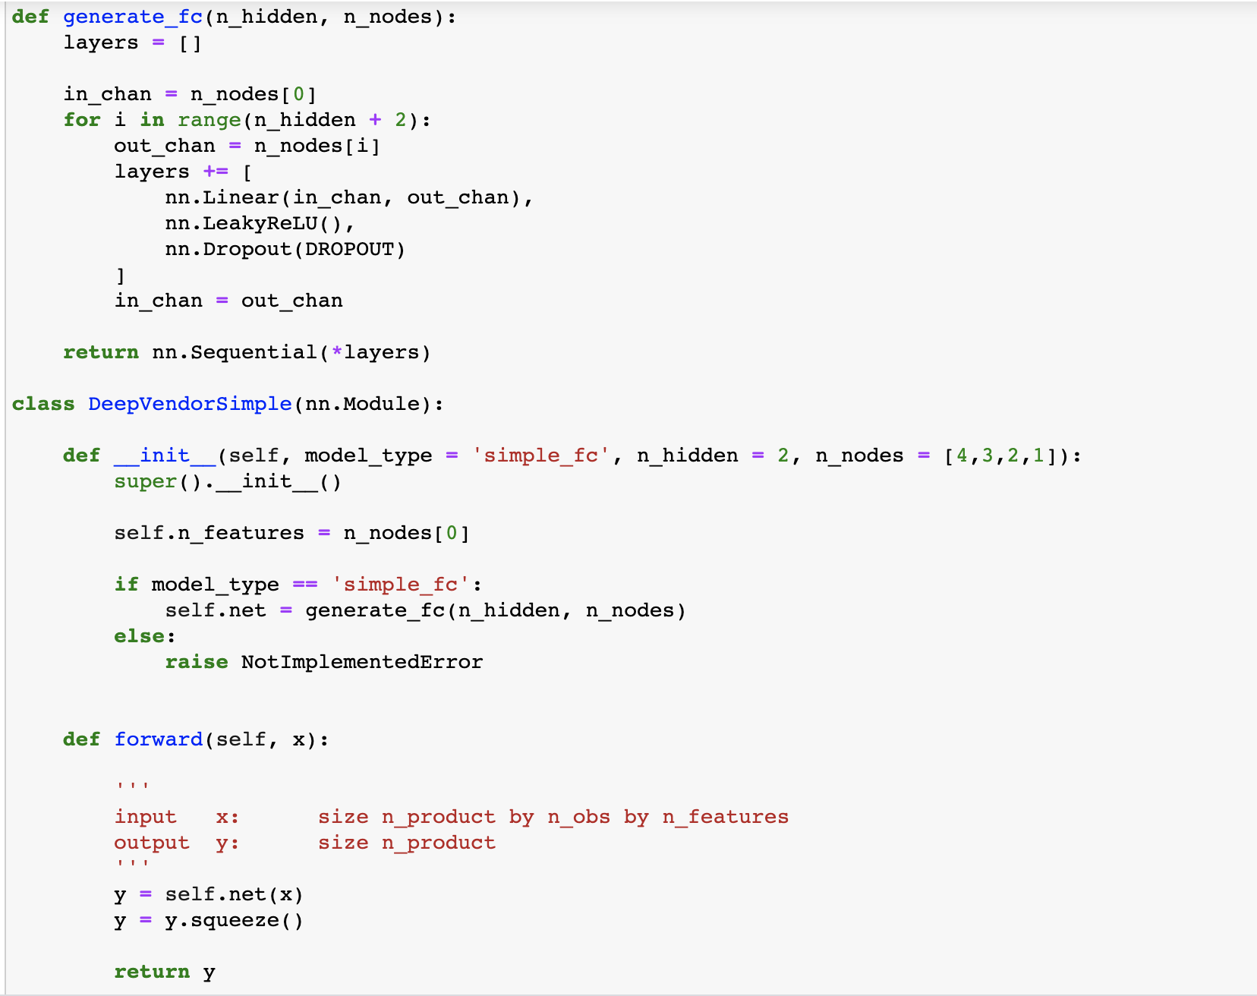

Slide 21
DNN – L1
Create 100 Feed Forward Neural Network models.
Loss Function used is L1 (Cost Function)
Iteratively remove the worst performing 10% models after training the models in steps of 5 epochs.
Criteria for accessing the performance of the model is Euclidean Loss evaluated on the test set.
Iterate till the final best model is obtained.

Slide 22
DNN – L2
Create 100 Feed Forward Neural Network models.
Loss Function used is L2. (Euclidean Loss Function)
Iteratively remove the worst performing 10% models after training the models in steps of 5 epochs.
Criteria for accessing the performance of the model is Euclidean Loss evaluated on the test set.
Iterate till the final best model is obtained.

Slide 23
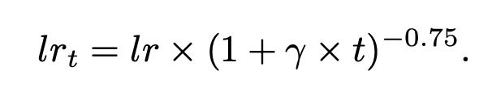
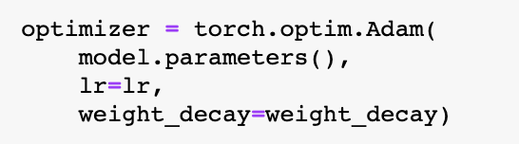
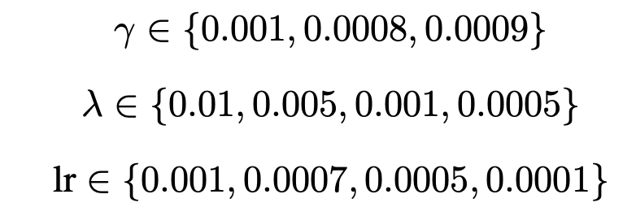
DNN L2 (Muti-level Optimization)
Fundamental Building Blocks
Optimizer : learn optimal weights
Learn Rate
Learning rate formulation
Optimizer
LEVEL 1 Grid Search
48 Models Trained

Slide 24
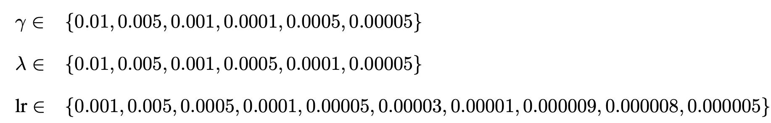
DNN L2 (Stage-2 Optimization)
LEVEL 2 Grid Search
(360 Models Trained)
Optimal Parameters Obtained

Slide 25
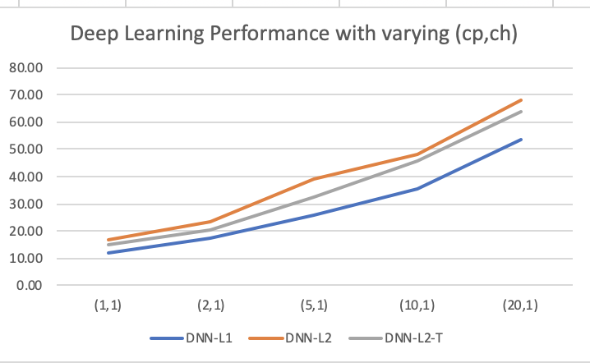
Deep Learning Results
Algorithm | (cp , ch)
 | (1,1) | (2,1) | (5,1) | (10,1) | (20,1)
DNN-L1 | 12.273 | 17.222 | 25.573 | 35.743 | 53.650
DNN-L2 | 16.848 | 23.153 | 38.970 | 48.400 | 67.882
DNN-L2-T | 14.883 | 20.455 | 32.489 | 45.998 | 63.877
Performance powered by high learning capacity of neural networks
Extremely sophisticated optimizer used: Adam
Can effectively capture non-linearity
Multi-level grid search further improved the performance

Slide 26
RESULTS
Algorithm | (cp , ch)
 | (1,1) | (2,1) | (5,1) | (10,1) | (20,1)
DNN-L1 | 12.273 | 17.222 | 25.573 | 35.743 | 53.650
DNN-L2 | 16.848 | 23.153 | 38.970 | 48.400 | 67.882
DNN-L2-T | 14.883 | 20.455 | 32.489 | 45.998 | 63.877
EQ | 45.776 | 76.351 | 130.526 | 177.590 | 228.102
EQ with Clustering | 45.717 | 76.322 | 130.725 | 177.551 | 227.331
KNN | 35.530 | 53.710 | 88.090 | 122.700 | 168.880

Slide 27
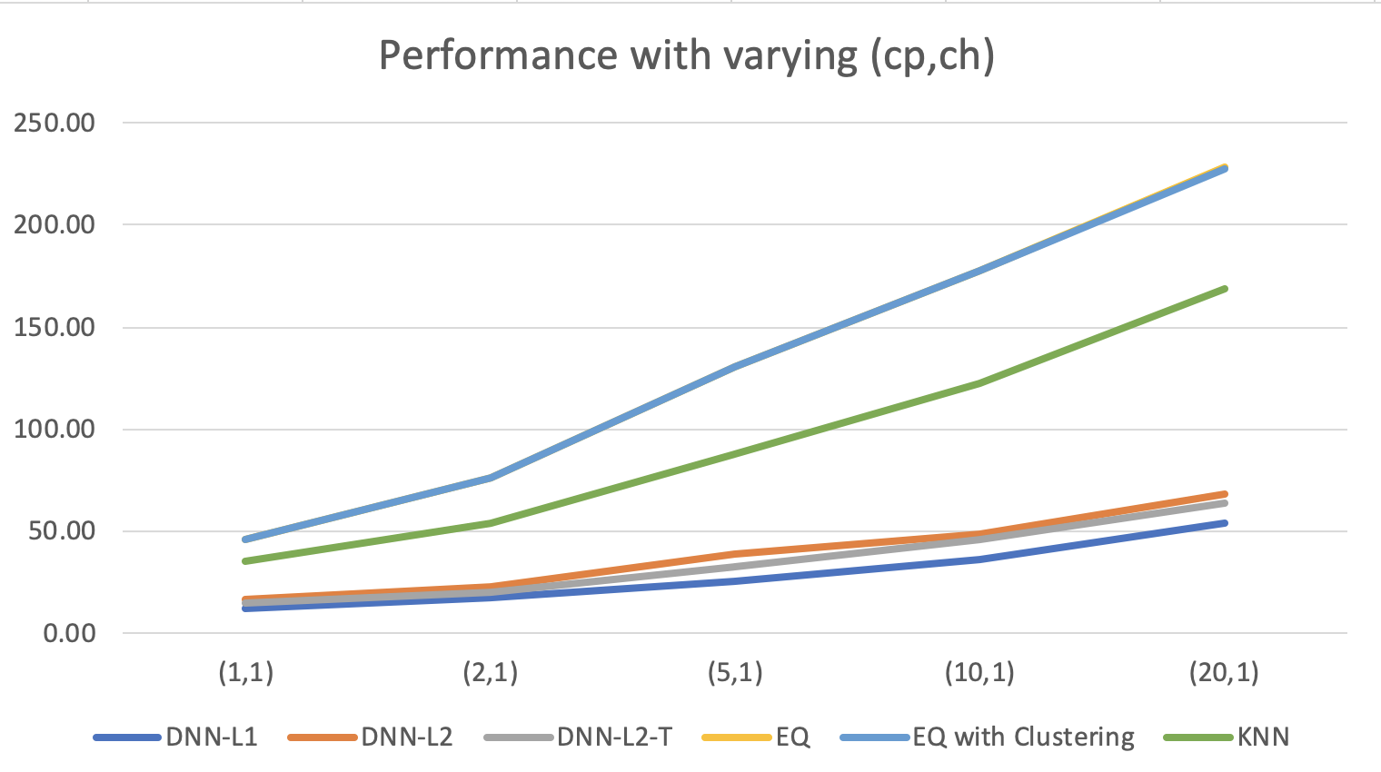
COMPARING RESULTS OF VARIOUS METHODS

Slide 28
CONCLUSION
Order of Model Performance
DNN-L1 > DNN-L2 – T > DNN-L2 > Traditional Approaches
Reason of High Performance of Deep Learning Models :
Non Linearity
Can learn complex relations

Slide 29



FUTURE SCOPE
Using features such as weather conditions, stock prices, location data etc
Performing same analysis for the case when there are multiple distribution channels.

Slide 30
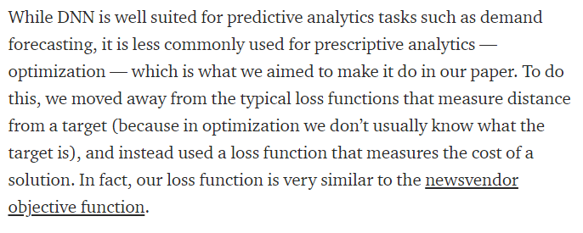
ADDITIONAL - DL
SEO – Separated Esimation and Optimization

Slide 31
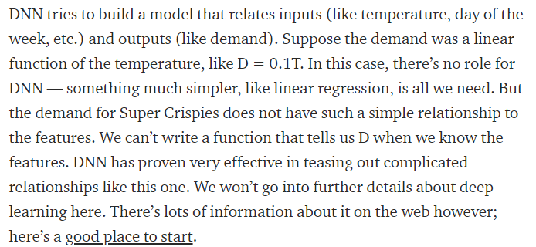
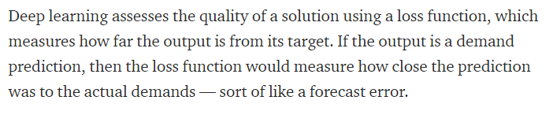
Additional - dl
SEO – Separated Esimation and Optimization

Slide 32
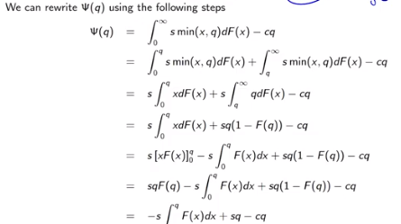
NEWSVENDOR PROBLEM WHEN DISTRIBUTION IS KNOWN

Slide 33
Topic flow
Intro – Problem Statement - Anuj
Data Description – KS Test (SEO not conducted) - Sisir
Traditional OR approaches (EQ and EQ with clustering) -Anand
ML KNN - Anand
DL – Intro + HyperBand Algo –Rahul10 –13
DL – Model Architecture + Results – Parth 14-23
DL – Final Comparison + final Conclusions + Way Forward – 24 –27 Prasun+ neelmani

Slide 34
References
Applying Deep Learning to the Newsvendor Problem, Afshin Oroojlooyjadid et.al.
https://medium.com/opex-analytics/machine-learning-for-inventory-optimization-38a9ac86a80a
Deep Learning Forward prop and Backprop Slides Credit – Debapriyo Majumdar, ISI

